Slide 1
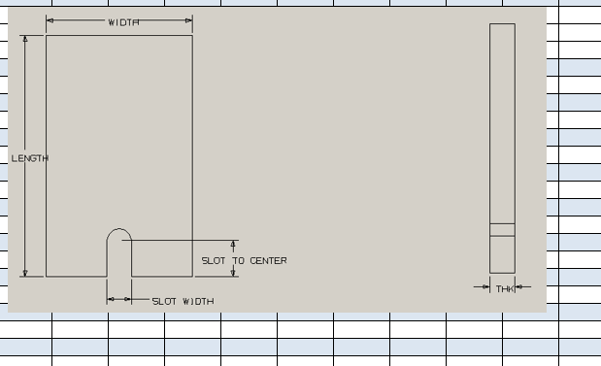
MAGNA AUTOTEK LOWER
125mm
135mm
98.5mm
63.5mm
35mm

Slide 2
MAGNA AUTOTEK UPPER
125mm
135mm
98.5mm
63.5mm
50mm

